Slide 1
Project
Telecom User Analytics

Slide 2
Libaries
Imported Libaries as below
pandas as pd
numpy as np
import matplotlib.pyplot as plt
import seaborn as sns

Slide 3
Data downloaded:
Command to download data used as below:
df = pd.read_csv(r"C:\Users\hp\Downloads\telcom_data (2).xlsx - Sheet1.csv",encoding="latin")

Slide 4
Rows and columns
To count and check names of rows and column below command:
print("Rows and Columns:", df.shape)print("\nColumn Names:")print(df.columns.tolist())

Slide 5
Data Cleaning
Missing values and duplicate records were checked and handled.
By commands as - df.head(), df.info(),files, df.describe(include="all").T, missing = df.isnull().sum().sort_values(ascending=False)print(missing), missing_percent = (df.isnull().sum() /len(df) * 100).sort_values(ascending=False)print(missing_percent), df = df.drop_duplicates()print("Rows after removing duplicates:",len(df)),

Slide 6
Numerial features:
Categorical variables were converted into numerical features before applying machine learning.
Numeric are distributed by:
df.select_dtypes(include=np.number).hist(figsize=(14, 10),bins=20)plt.tight_layout()plt.show()

Slide 7
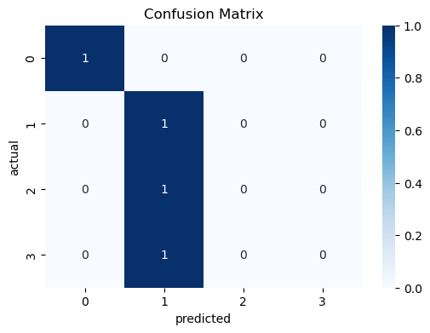
Confusion matrix visualization

Slide 8
Features importance:
 | feature1 | 0.533333
 | feature2 | 0.466667

Slide 9
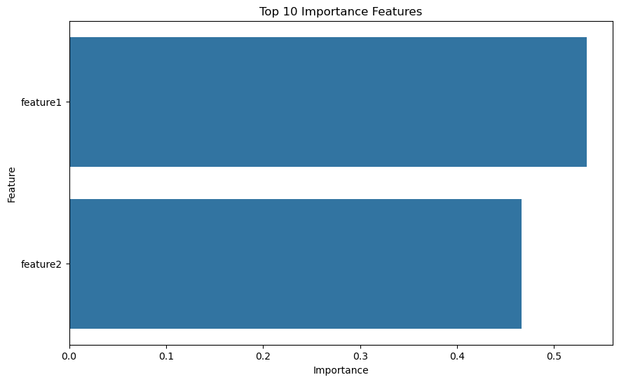
Feature importance graph

Slide 10
Conclusion:
The Telecom User Analytics project demonstrates how data cleaning, exploratory analysis, machine learning and feature importancecan be combined to generate useful business insights from telecom customer data.

